Slide 1

Tendo OOP model for Existing Users
Presented by:
Data Science
CEO Update: 22th April 2025

Slide 2
OOP model 1st Draft: Target definition
Final Payment - Leave date + | TPSD | TPSD | TPSD | TPSD |  | Leave date
Final Payment + | TPSD | TPSD | TPSD | TPSD |  |  | Final payment |  |  | Last Paid Due Date
Final Payment + | TPSD | TPSD | TPSD | TPSD |  | Last Paid Due Date | Final payment
Check self payments
Check self payments
Check self payments
Check self payments
Observation window = 5 month
Performance window = 2 month (with exception in scenario 2)
We consider only employees with known resignation date, permanent freeze date or final payment.
We consider only cases with OSBal > 0 after last TPSD and Final Payment

Slide 3
OOP model: Concepts of Onboarding Cohorts and Observation Window
 | 2023 |  |  | 2024
Calculation dates | Oct | Nov | Dec | Jan | Feb | Mar | Apr | May | Jun | Jul
Train data [3 156]: randomly selected calculation date
Test data [791]: randomly selected calculation date
We take only those Employees who are Active Employees with that Employer AND Active Tendo Customers as of the Calculation Start Date
We take only Employees with known resignation date, permanent freeze date or final payment date
We calculate the Features for those Employees and their Employers as of selected Calculation Date

Slide 4
OOP model: Features
# | Feature Name | Description
1 | Time from onboarding to first loan purchase | [Numerical] Calculated as the number of days between the onboarding date and the datetime of the first Approved/Disbursed loan application.
2 | Employee's Phone Telco Name | [Categorical] Identified based on the phone number prefix. Possible values: Globe, Smart, Dito, Other.
3 | Employee's email domain | [Categorical] Identified based on the email domain. Categories: Popular (e.g., Gmail, Yahoo, Outlook), Corporate, Others.
4 | Employee's Age | [Numerical] Calculated as the age in years on the calculation date, based on birthdate. Missing values and ages over 70 are replaced with the median (31 years).
5 | Employer size based on data from JobStreet | [Categorical] Retrieved from JobStreet for the top 75 Tendo employers. For employers not listed on JobStreet or not in the top 75, the value is set to 'Missed'.
6 | Lead role in job title | [Binary] Indicates whether the raw job title contains keywords related to a lead role.
7 | Disbursed channel = 'gcash' | [Binary] Indicates whether the loan was disbursed via GCash. Assigned a value of 1 if at least one loan was disbursed through GCash; otherwise, 0.
8 | Total outstanding balance | [Numerical] Sum of outstanding balances for all Approved/Disbursed loans as of the calculation date.
9 | Number of active loans | [Numerical] Count of active loans as of the calculation date.

Slide 5
OOP model: Performance
CatBoost
Train/Test | Time period | Gini
Train | Jan 2023 – Mar 2024 | 0.3520
Test | Apr 2024 – Dec 2024 | 0.3280
Test | Apr 2024 | 0.3246
Test | May 2024 | 0.3795
Test | June 2024 – Dec 2024 | 0.3231

Slide 6
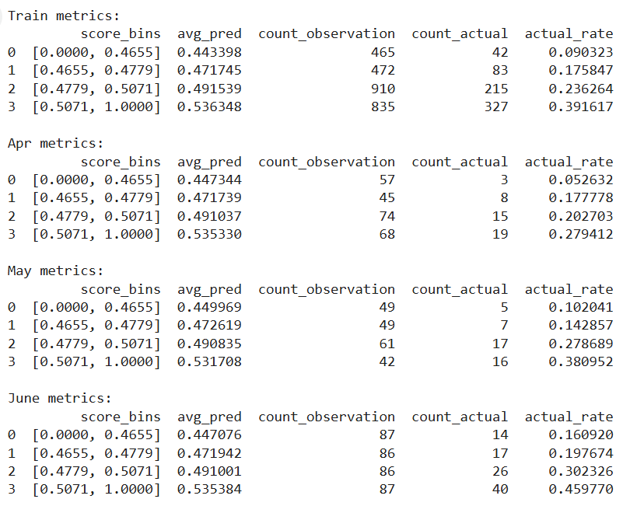
OOP model: 4 bins

Slide 7
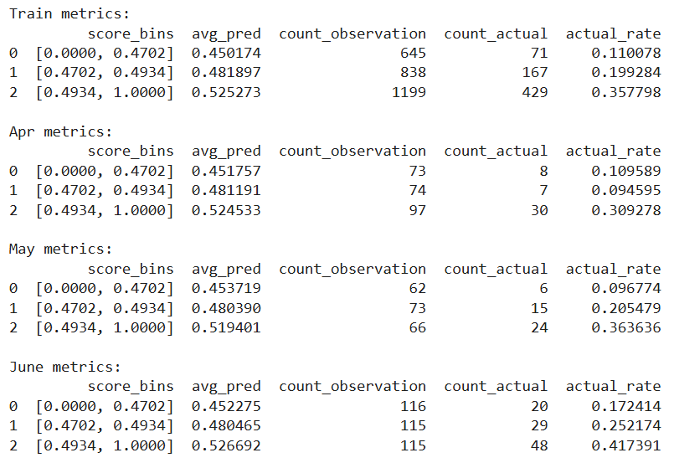
OOP model: 3 bins

